Slide 1
Improving the Windows Update experience

Slide 2
Goals
Customers resist updating Windows, so I changed the text to:
Better express the value of updating
Reflect the core brand text principles
Focus on the desired customer behavior
Notes:
* Text principles: being “warm and relaxed, crisp and clear, and ready to lend a hand”
* Focus on one outcome rather than presenting all possible options to the customer

Slide 3
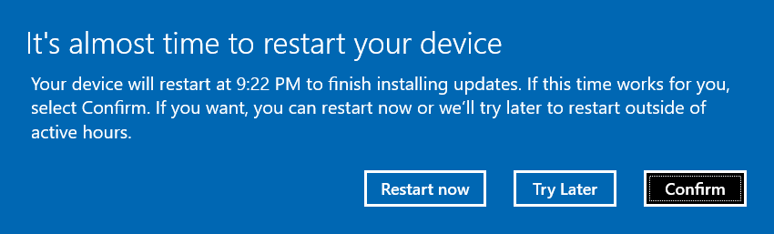

Basic auto-restart reminder
If the customer is set up to get updates automatically and we detect they’re not busy, we’ll show this reminder 15 minutes prior to the update starting:
Before
After
We’ve got an update for you
Windows is a service and updates are a normal part of keeping it running smoothly. Your update is scheduled for 9:22 PM. Or, select Restart now if you’re ready to do it now.
Restart now
Another time
OK

Slide 4
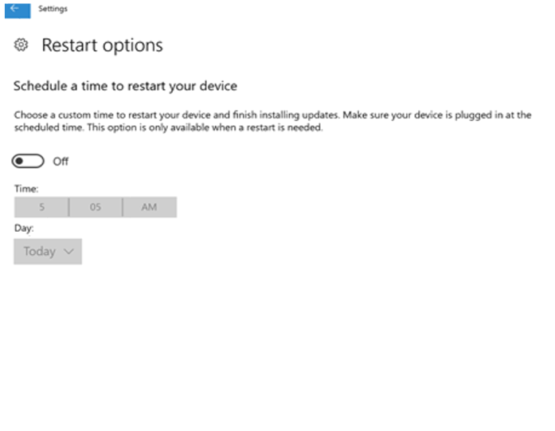
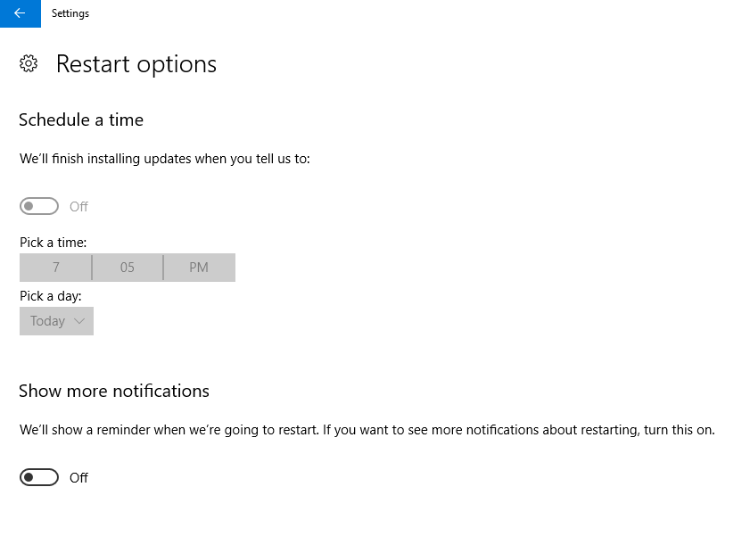
Auto-restart options and notifications
Before
After
Notes:
The old text was shortened and simplified, and the new setting shows the notifications that we chose to hide by default in this release to make the restart seem less intrusive.

Slide 5
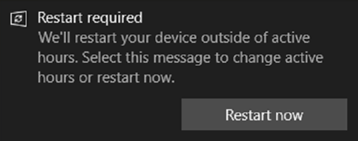
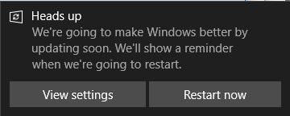
“Auto-restart pending” notification
If the notification setting is turned on and a restart is pending, we show this message:
Before
After
Notes:
Tapping the notification (as opposed to the Restart now button) takes customers to Settings. That behavior is odd, so we made it explicit by adding a (redundant) View settings button.

Slide 6


“Auto-restart occurred” notification
If notifications are turned on and a restart occurred, we show this message:
Before
After
Better every time
See what’s new or changed in Windows

Slide 7
“Engaged restart” message 1
If we tried to update but couldn’t because the customer’s PC was asleep, we show this message:
Before
After
Restart your device to finish installing updates
We’ve got an update for you
Windows is a service and updates are a normal part of keeping it running smoothly. We need your help installing this one.
Ready? Restart now. Not ready? Pick a time that works for you.
We tried but were unable to install updates outside of your active hours, so you’ll need to restart your device. You can restart now or schedule for a convenient time. Make sure you save your work before restarting.
Restart now
Schedule
Remind me later
Restart now
Pick a time
Snooze
Notes:
“Engaged” means we have to engage with the customer because their device isn’t available when we were expecting it to be. It might’ve been asleep, the customer delayed updates, or some other reason.

Slide 8
“Engaged restart” message 2
If the customer chooses not to restart, we’ll show them this message after 7 days has passed:
Before
After
Restart to keep your device running smoothly
Let’s get better together
Don’t sleep on this update – we want you to have the latest improvements so Windows runs smoothly and more securely.
Ready? Restart now. Not ready? Pick a time that works for you.
To ensure your device is up to date, you need to restart to install the latest updates. You can choose to restart now or schedule for a convenient time. Make sure you save your work before restarting.
Restart now
Schedule
Remind me later
Restart now
Pick a time
Keep snoozing

Slide 9
“Engaged restart” message 3
After 14 days, we show this message:
Before
After
Don’t forget to restart
Let’s cross this one off your list
Getting up to date now means Windows will run better and be more secure. We need your help installing this update.
Ready? Restart now. Not ready? Pick a time that works for you.
We still need to finish installing updates. You can choose to restart now or schedule for a convenient time. Make sure you save your work before restarting.
Restart now
Schedule
Remind me later
Restart now
Pick a time
Keep bugging me

Slide 10
“Engaged restart” reminder
Once the customer has chosen a time to restart, we’ll show them this reminder:
Before
After
Your device is scheduled to restart
Countdown to goodness…
We’re going to do the update you scheduled at 9:22 PM. Or, select Restart now if you’re ready to do it now.
Your scheduled restart will occur at 10:30 PM to finish installing updates. Make sure you save your work before restarting. You can also choose to restart now or reschedule for a different time.
Restart now
Reschedule
Confirm
Restart now
Pick a time
OK

Slide 11
“Engaged restart didn’t work” message
If we weren’t able to restart when the customer scheduled us to, then we’ll show this message:
Before
After
We were unable to restart your device
Let’s get our groove back
We couldn’t update Windows because your device didn’t show up for our date at 10:30 P.M. yesterday. Maybe it was turned off or the battery was low? Select Restart now to get going again.
Your device was unavailable at 10:30 P.M. yesterday, so we weren’t able to perform your scheduled restart to install updates. If you want, you can restart now or we can try again in an hour.
Restart now
Try later
Restart now
Wait an hour

Slide 12
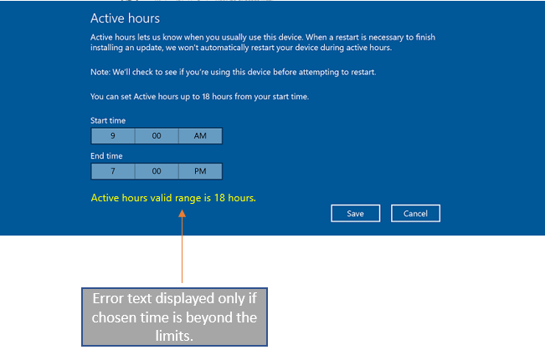
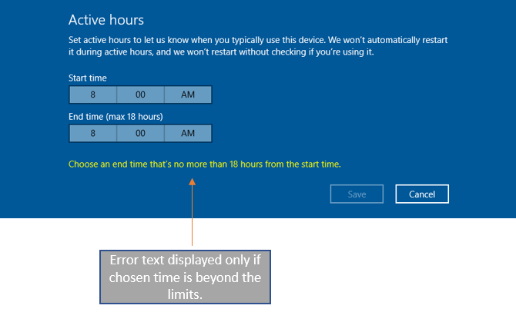
“Active hours” settings
How customers tell us when to update their device.
Before
After

