Slide 1
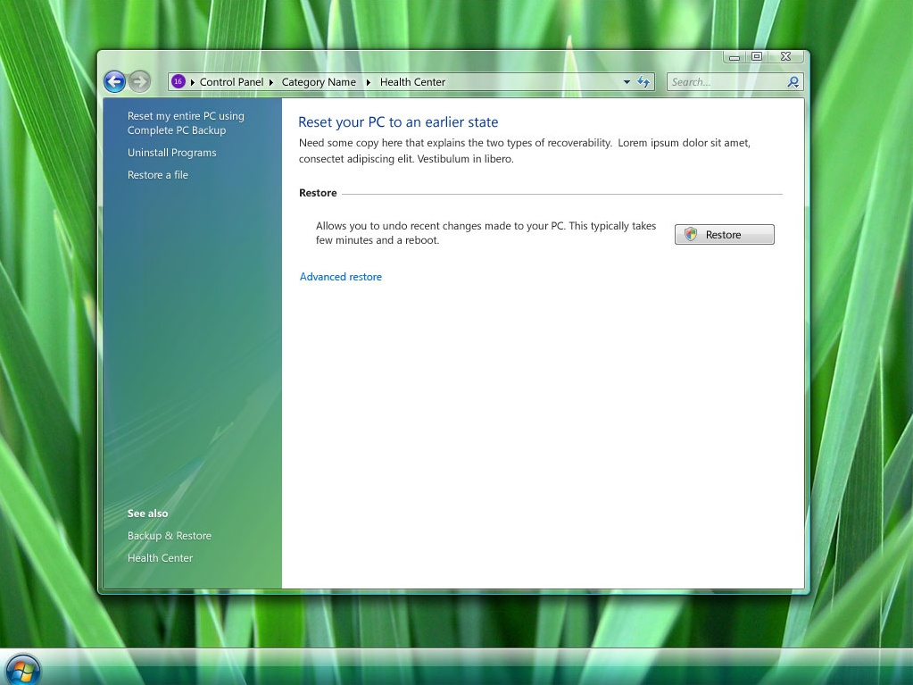
Take a Complete PC Backup
Uninstall a program
Restore a file
Restore this computer to an earlier point in time
?
Create an image backup*
Uninstall a program
Restore a personal file
Troubleshoot a problem
For minor problems, try System Restore. For serious problems, use the advanced recovery methods to re-image your computer or restore it to factory condition.
If you notice system problems, you can roll back Windows to an earlier time when things worked correctly. Before you try restoring, you can also try to troubleshoot the problem.
System Restore
Undo changes to system files and programs, but leave user files such as documents, pictures, and music untouched. This might uninstall recently-installed programs and drivers. How does System Restore work?
Undo changes to system files and programs but leave documents, pictures, and other personal data untouched. Recently-installed programs and drivers might be uninstalled as a result.
*ad-hoc image backup is not in all skus, fyi
Advanced recovery methods
Advanced recovery options
Windows Solutions Center

Slide 2
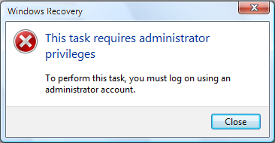
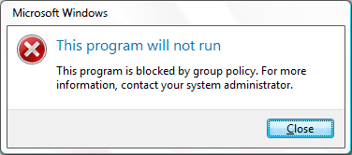
Recovery
You need to be an administrator to perform this task
Log in using an administrator account and try again.
Close
Windows Recovery Center
Cannot launch %application name%
Recovery
Could not start <program_name>
Close any open programs and try again.
Close
Windows has insufficient resources to complete this action. Try another reset option or try again later.
CPL Tooltip:
CPL Tooltip:
Restore your system files to an earlier time, or replace everything on your computer with an image backup you created earlier.

Slide 3
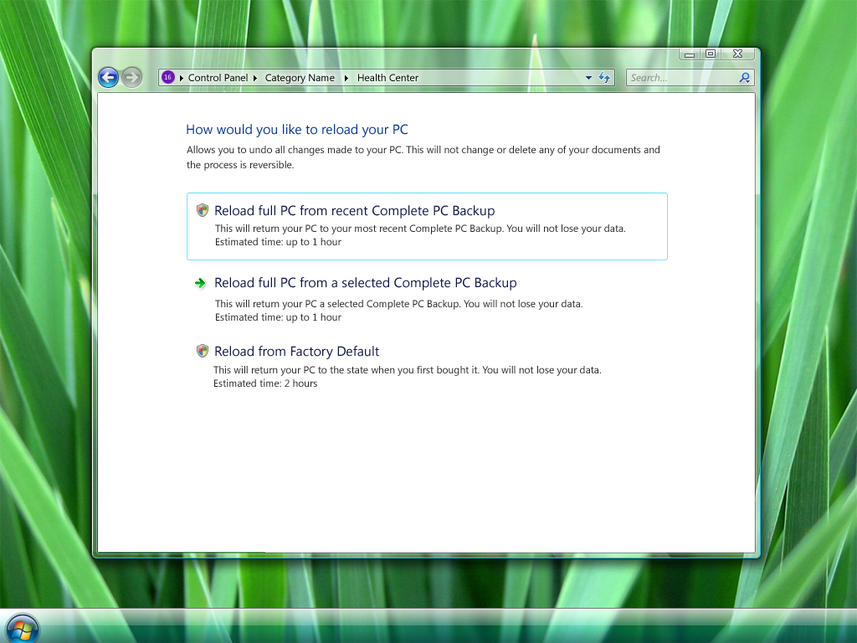
Choose an advanced recovery method
Before either method begins, you’ll have the opportunity to back up user files, such as documents, pictures, and music.
Help me choose a recovery method.
Choose an advanced recovery option
Before you begin either option, you can create a backup of all your personal files, which you can then restore later.
Re-image your computer
If you have previously backed up your computer’s system files, you can use the backup to replace everything on this computer--including Windows, your programs, and all your user files--with the information saved on the system image. What’s a system image?
Restore your computer from a System backup
Replace everything on your computer—Windows, your programs, and all your personal files-- with a System backup that you made earlier. Everything currently on your computer will be replaced with the files and programs you had when you made the backup.
Reinstall Windows
Return your computer to factory condition (reinstall Windows)
Warning: This option deletes everything, including user files and programs, and resets Windows to factory condition. Afterward, you will need to reinstall all of your programs using your original installation discs or files.
Warning: This option installs a fresh copy of Windows on your computer. You will need to reinstall your programs using the original installation discs or files.
What if you have partitioned? Does it just reinstall windows on C?

Slide 4
Recovery
Do you have a Windows installation disc?
Windows could not find the files needed to reinstall the operating system. If you have an installation disc, click Yes and you will be prompted to insert the disc later.
Yes No
Windows Recovery Center
Do you have a Windows Install CD?
Windows could not find the files to re-install the operating system. If you have the Windows installation DVD click Yes and follow the steps in subsequent screens. You will be prompted when to insert the CD.
Yes
No

Slide 5
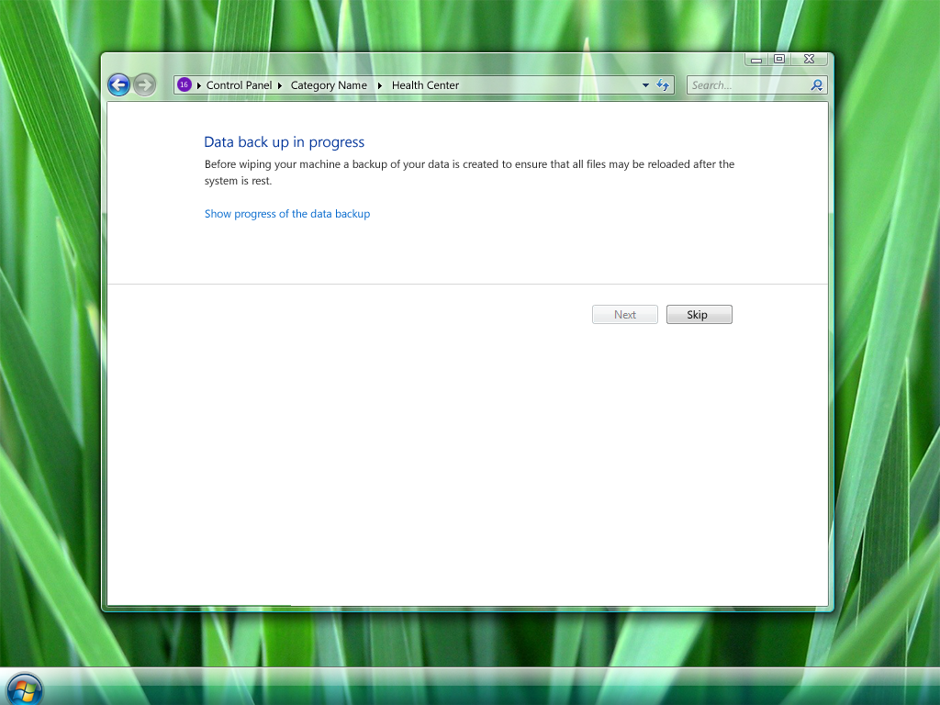






Windows 7 Desktop – Troubleshoot My PC: PC Health Center – Design Option 2
Restore my PC
First we create an undo SR point
Before you begin: Do you want to back up user files?
Before continuing with the system recovery, you can back up your user files, such as documents, pictures, and music, to an external hard disk, DVD, CD, or USB flash drive. That way you’ll have the most recent version of your files.
After the recovery process is completed, Windows will help you restore these files to your computer. If you skip this step, you might lose user files.
Back up your files, pictures, and other personal data
Create a data backup of your files to an external location, such as an external hard disk, DVD, CD, or USB flash drive. After the computer restore completes, Windows will guide you to restore this data backup. If you skip this step, your personal data on the computer might be deleted.
Control Panel
PC Health Center
Reset My PC
Last backup of your personal data: 7/26/2007 11:53 AM
Location of your last backup: Data (F:)
Health Center - Fix, Troubleshoot and Maintain your PC
PC Health Center Home
This should take several (30-60) seconds
IGNORE
I want to take a Complete PC Backup before continuing . This will allow you to undo your selected reset operation
Refresh actions
Last user file backup created: 07/26/2007 11:45 AM
Actions
Advanced Reset
Troubleshoot
Back up now
This will create an undo point and then reboot your PC
Find a solution to fix problems you are experiencing
Restore the PC to an earlier point in time
Get Support to help you fix your problem
Error case 1 (where “Last user file backup appears”):
You cannot create a backup while Windows is running in Safe mode. If you skip this step, your user files might be deleted. Show me other ways to back up my data.
(back up button would be grayed out)
Creating an undo point…
Maintenance
Security Center
Backup and Restore
Turn automatic updating on or off
Check for updates
Last back up was run on 11/20/2006
run backup
Error case 2:
Windows could not find any user file backups on this computer. Click Back up now to create a file backup.
Reliability Center
Windows Update
8 new solutions have been found
Review solutions
Check for updates
View installed updates
Performance Tools
Use tools to improve your performance
View the Windows Experience Index
Cancel
1:15 PM

Slide 6
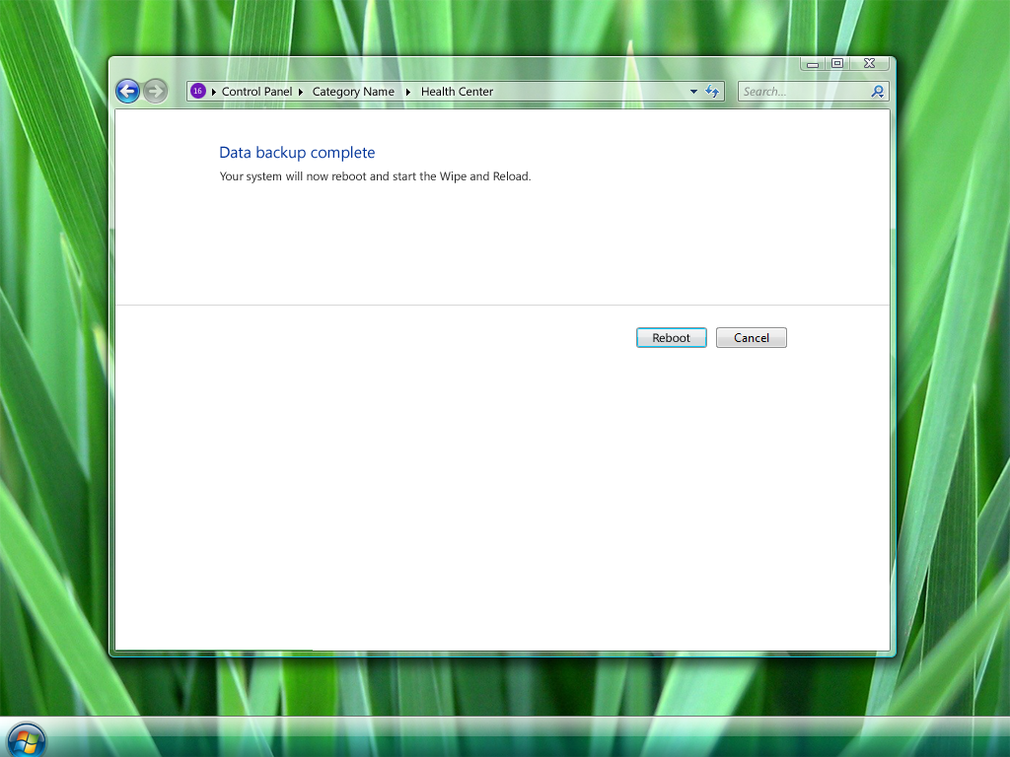

Restart your computer and continue the recovery
If you are restoring from a system image, the System Recovery Options menu will open after the computer restarts. Select Re-image your computer to continue the recovery process.
If you are resetting Windows to factory condition, follow the instructions that will appear on your screen.
Restart your computer and continue with the restore process
If you are restoring your computer from a System backup, you’ll be able to select your backup date if more than one exists.
You cannot backup your documents, pictures, and other personal data when you are in Safemode. If you proceed with the restart you might lose these files. Show me other ways to backup my data
Restart to continue
Cancel
Cancel
Restart
Other label for button: Restart and continue?

Slide 7
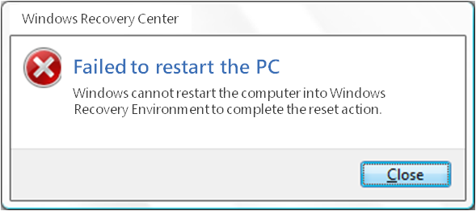
Recovery
Windows could not open the recovery environment (WinRE)
The computer could not be restarted into the Windows Recovery Environment (WinRE).
Close
Mujtaba: This seems really nasty—we need a better scenario here…
Windows Recovery Center
Data Backup has not completed successfully. Do you still want to continue?
You will lose your documents, pictures, and other personal data if you proceed with the reset operation without first doing a data backup.
Yes
No
Recovery
User file backup could not complete. Do you want to continue the recovery?
Warning: If you continue, your user files might be deleted.
Continue with recovery Cancel

Slide 8
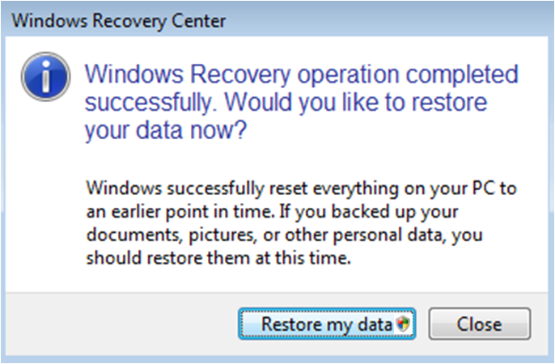
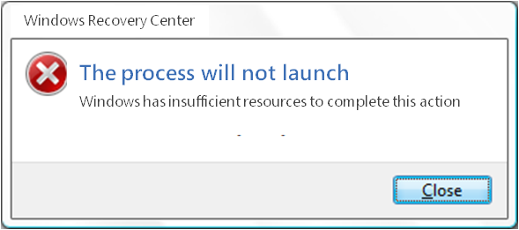
Recovery
Recovery has completed. Do you want to restore your user files?
If you created a user file backup before recovering your computer, you can restore those files now.
Restore my files Cancel
Recovery
Could not start <program_name>
Close any open programs and try again.
Close
Recovery
The recovery process was cancelled
Close

