Slide 1
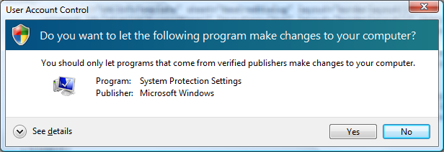
Windows program, installer, or task
Do you want to allow the following Windows program to make changes to this computer?
Verified Publisher: Microsoft Windows
Program Name: System Protection Settings
Verified Publisher: Microsoft Windows
Help me decide
Do you want to allow the following Windows program to install software on this computer?
Verified Publisher: Microsoft Windows
CS: I need a real example of this, if there is one
Program Name: X installer
Verified Publisher: Microsoft Windows
Help me decide
Do you want to allow the following Windows task to make changes to this computer?
Verified Publisher: Microsoft Windows
Task Name: File Operation
Verified Publisher: Microsoft Windows
Help me decide

Slide 2
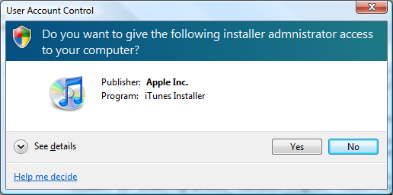
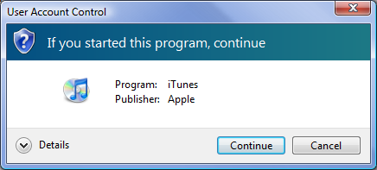
Signed 3rd party program, installer, or task
Do you want to allow the following program to make changes to this computer?
Program Name: iTunes
Verified Publisher: Apple, Inc.
Do you want to allow the following program to install software on this computer?
Program Name: iTunes Installer
Verified Publisher: Apple, Inc.
I am not sure if there is a such things as a 3rd party task—I am finding out. Here is the Main instructions, the rest would be the same as the text above but “Program Name would be “Task Name”
Do you want to allow the following task to make changes to this computer?

Slide 3
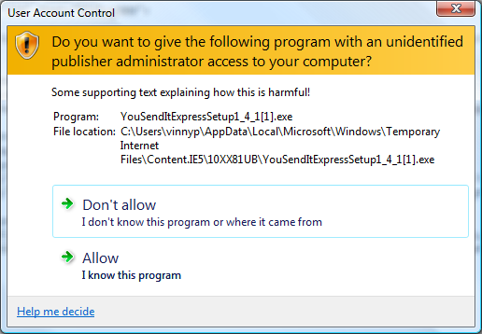
Unsigned—means there is no publisher listed or certificate
A program from an unidentified publisher wants to make changes to this computer
CS: Do you think we need both of these sentences. The first one ties into the command links. I am thinking of switching the first and second sentence or removing the first one all together.
Tholse: Have you considered moving the program name and file location to be the first thing in the box? That’d go better with the main instruction. I’d also include: “Publisher: Unknown” to reinforce the sketchiness. I don’t mind there being two sentences. They seem clear enough (see my comment, though), and a user will only read the info on this dialog once before the only thing they’ll look at is the program name and the command links.
You should only allow programs that you started and come from known publishers make changes to this computer. If you allow this program to make changes, the security of this computer might be compromised.
Program Name: YouSendItExpressSetup.exe
File Location: C:\Users\Molly\Temporary Internet Files\YouSendItExpressSetup.exe
I didn’t start this program or I don’t know where it came from.
I started this program and I know where it came from.

Slide 4
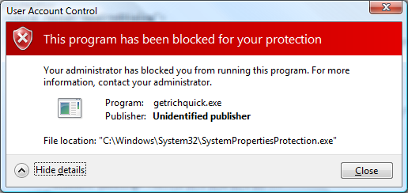
Blocked
Program Name: getrichquick.exe
Publisher: Untrusted

Slide 5
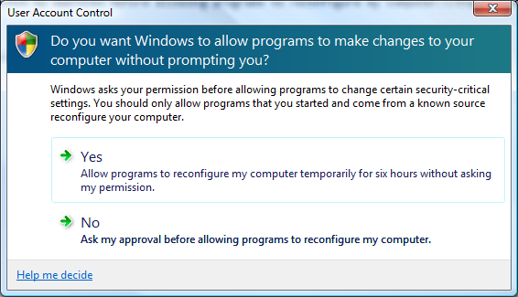
Install mode—users can opt out of prompts for signed programs for 6 hours
Do you want to automatically allow programs with verified publishers to make changes to this computer?
You will continue to be prompted for permission when a program with an unidentified publisher tries to make changes to this computer.
Yes
Allow programs with verified publishers to make changes to this computer without prompting me for the next six hours.
No
Ask for my permission before allowing any program to make changes to this computer.

